Slide 1
Group 9 Presentation
Brandon Dooley, William Harty, Arthur Sasunts, Michael McAndrew, Cian Begley

Slide 2
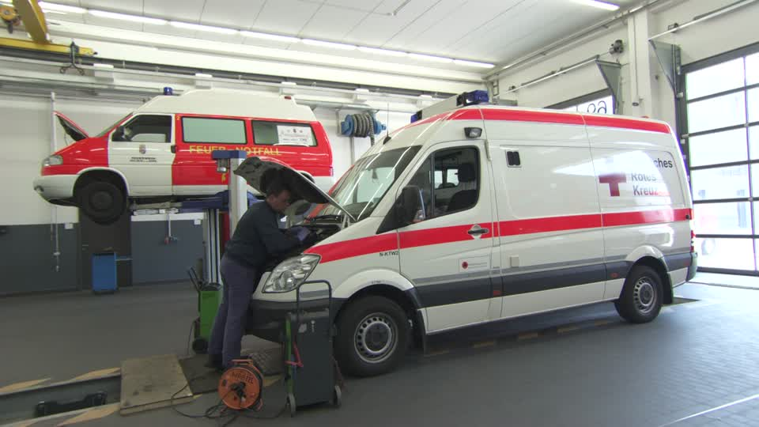
Problem being tackled?
Emergency Services Vehicle Maintenance Management
Notes:
The problem that we have decided to tackle is designing an information model to handle all of the data/information associated with the Vehicle Maintenance Management of a chosen department within the Emergency Services. We have decided to explore the problems associated with the Vehicle Maintenance management of the Ambulance services.

Slide 3
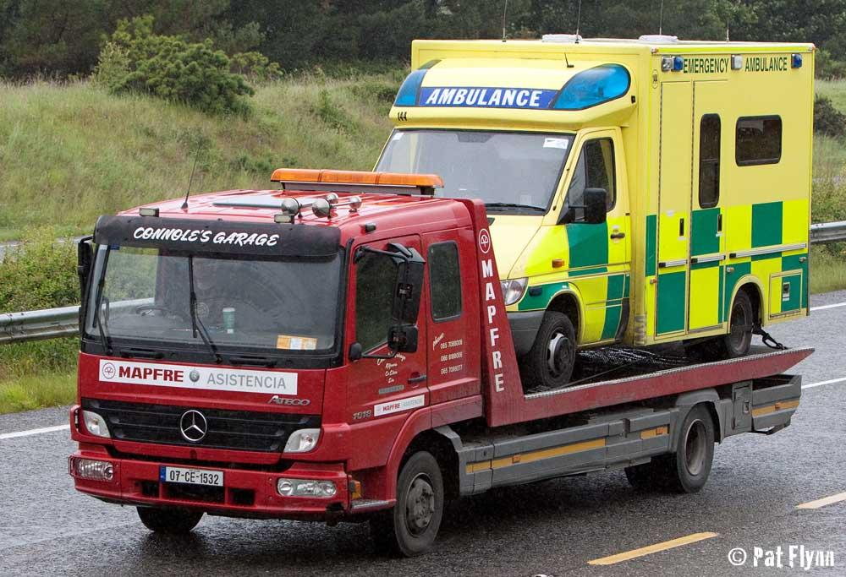
Why is this a problem?
Ensuring vehicles are safe for operation
Recording when vehicles next need repairs
In order for services to run efficiently
Keeping track of records regarding the entire fleet
Managing stock of repair parts
Notes:
There is a vast amount of information associated with such a topic and there can be serious consequences if they are not handled/managed properly. Emergency service vehicles need to be maintained to an extremely high standard to ensure they can continue to perform their job efficiently. If not correctly maintained there is a possibility that they will not be able to accommodate all call-outs, thus endangering the general public.

Slide 4
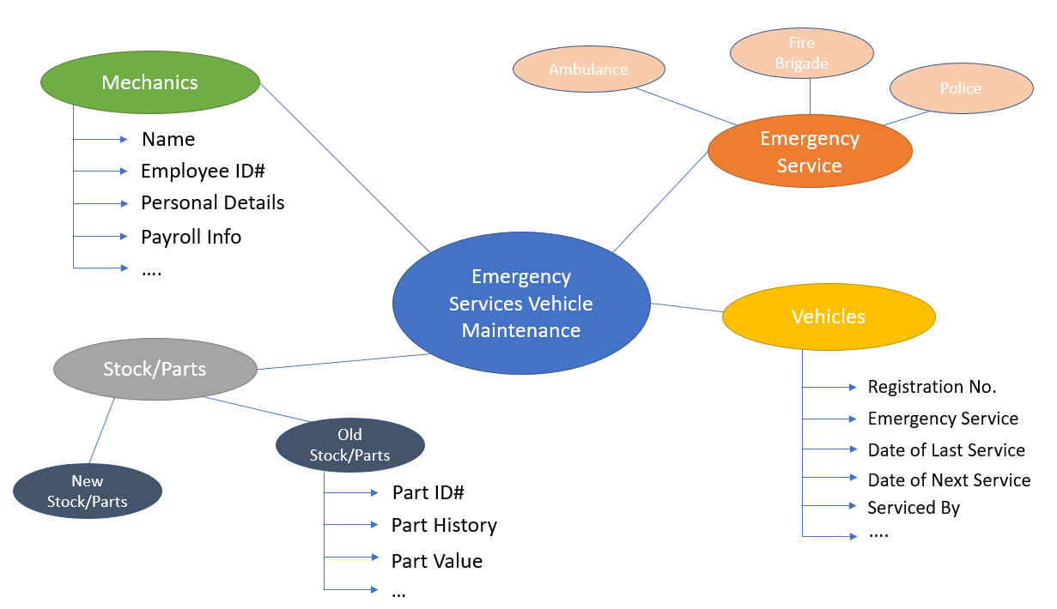
Notes:
The above web diagram explores some of the various actors involved in an Emergency Services Vehicle Maintenance information model. It also explores the various bits of information that is associated with them.

Slide 5
Research done

Slide 6
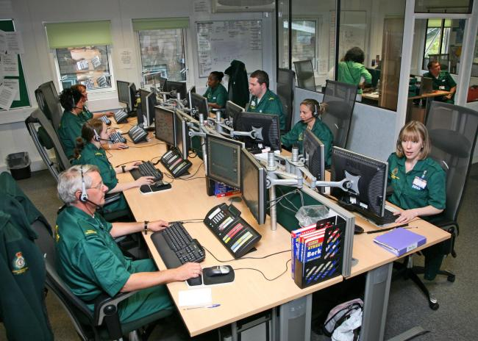
A System To Manage Call Outs
Keeps track of incoming calls.
Analysis can be carried out to give most on demand times.
Provides vital information for operations managers.
Notes:
The first idea that we discussed was a system to manage call outs. We believe that this system is important to our model because it keeps track of incoming calls, analysis can be carried out to give most on demand times and as a result, provides vital information for operations managers.

Slide 7
A System To Manage Call Outs
Keeps track of incoming calls.
Analysis can be carried out to give most on demand times.
Provides vital information for operations managers.
Notes:
The first idea that we discussed was a system to manage call outs. We believe that this system is important to our model because it keeps track of incoming calls, analysis can be carried out to give most on demand times and as a result, provides vital information for operations managers.

Slide 8
A System To Manage Call Outs
Keeps track of incoming calls.
Analysis can be carried out to give most on demand times.
Provides vital information for operations managers.
Notes:
The first idea that we discussed was a system to manage call outs. We believe that this system is important to our model because it keeps track of incoming calls, analysis can be carried out to give most on demand times and as a result, provides vital information for operations managers.

Slide 9

2. Staff Management
Work times.
Hours worked.
Number of staff present.
Notes:
The second idea that examined was staff management. This is aspect looks at how the staff are being managed within the workforce. Staff management is important as it monitors work times, the amount of hours worked and the number of staff present on the day.

Slide 10
2. Staff Management
Work times.
Hours worked.
Number of staff present.
Notes:
The second idea that examined was staff management. This is aspect looks at how the staff are being managed within the workforce. Staff management is important as it monitors work times, the amount of hours worked and the number of staff present on the day.

Slide 11
2. Staff Management
Work times.
Hours worked.
Number of staff present.
Notes:
The second idea that examined was staff management. This is aspect looks at how the staff are being managed within the workforce. Staff management is important as it monitors work times, the amount of hours worked and the number of staff present on the day.

Slide 12
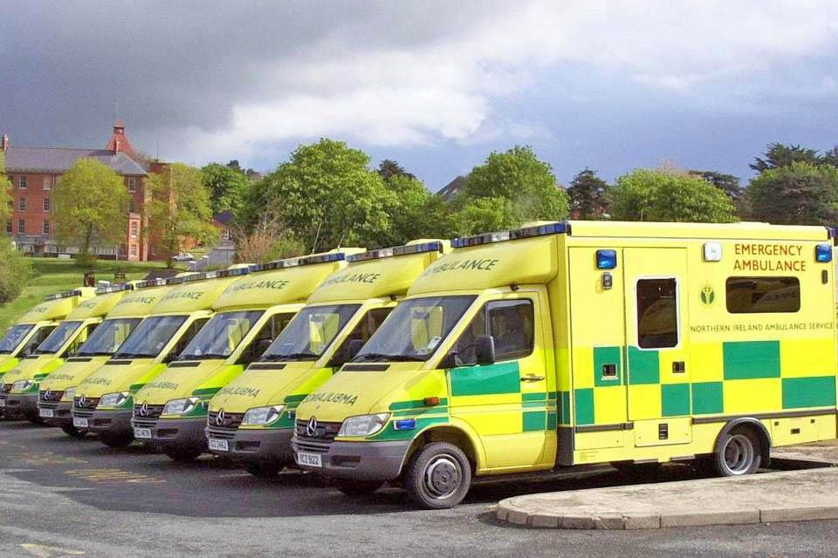
3. Vehicle Fleet Management
How many vehicles that are in the fleet.
How many are available at a time of an emergency.
How many need to be serviced/replaced.
Notes:
The third idea that we observed was vehicle fleet management. This is also an important aspect of our model as it keeps all of the emergency vehicles in check. It confirms the amount of vehicles that are in the fleet, how many that are available at a time of an emergency and how many that need to be services or replaced.

Slide 13
3. Vehicle Fleet Management
How many vehicles that are in the fleet.
How many are available at a time of an emergency.
How many need to be serviced/replaced.
Notes:
The third idea that we observed was vehicle fleet management. This is also an important aspect of our model as it keeps all of the emergency vehicles in check. It confirms the amount of vehicles that are in the fleet, how many that are available at a time of an emergency and how many that need to be services or replaced.

Slide 14
3. Vehicle Fleet Management
How many vehicles that are in the fleet.
How many are available at a time of an emergency.
How many need to be serviced/replaced.
Notes:
The third idea that we observed was vehicle fleet management. This is also an important aspect of our model as it keeps all of the emergency vehicles in check. It confirms the amount of vehicles that are in the fleet, how many that are available at a time of an emergency and how many that need to be services or replaced.

Slide 15
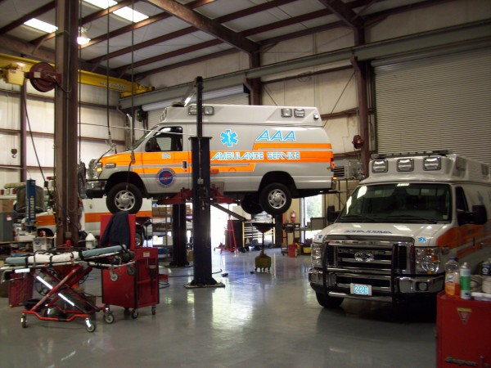
4. Vehicle Maintenance System
Vehicle servicing.
Check-ups.
Repairs.
Notes:
The final idea that we reviewed was the vehicle maintenance system.

Slide 16
4. Vehicle Maintenance System
Vehicle servicing.
Check-ups.
Repairs.
Notes:
The final idea that we reviewed was the vehicle maintenance system.

Slide 17
4. Vehicle Maintenance System
Vehicle servicing.
Check-ups.
Repairs.
Notes:
The final idea that we reviewed was the vehicle maintenance system.

Slide 18
UML Use Cases

Slide 19
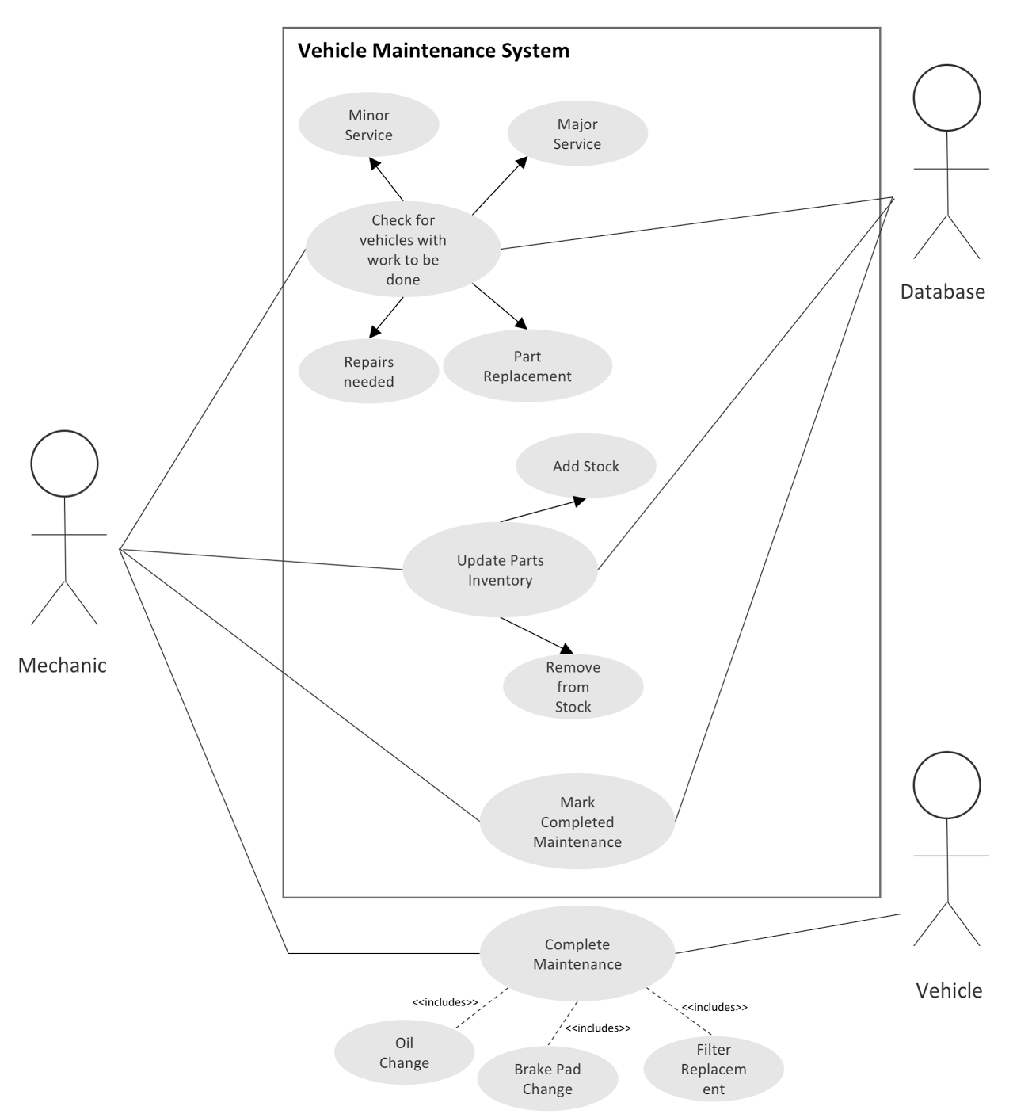
UML Use Case Diagram
Notes:
The use case diagram illustrates the relationship between the different use cases and the various actors. For instance, the diagram conveys how the mechanic updates the parts inventory. The mechanic interacts with the database to perform the update, doing which means he/she must either choose to add to stock or remove from stock, ie. ‘Add to stock’ and ‘Remove from stock’ use cases both ‘extend’ the use case ‘Update Parts Inventory’. Similar relationships are illustrated between the actors and other use cases.

Slide 20
UML Class Diagram

Slide 21
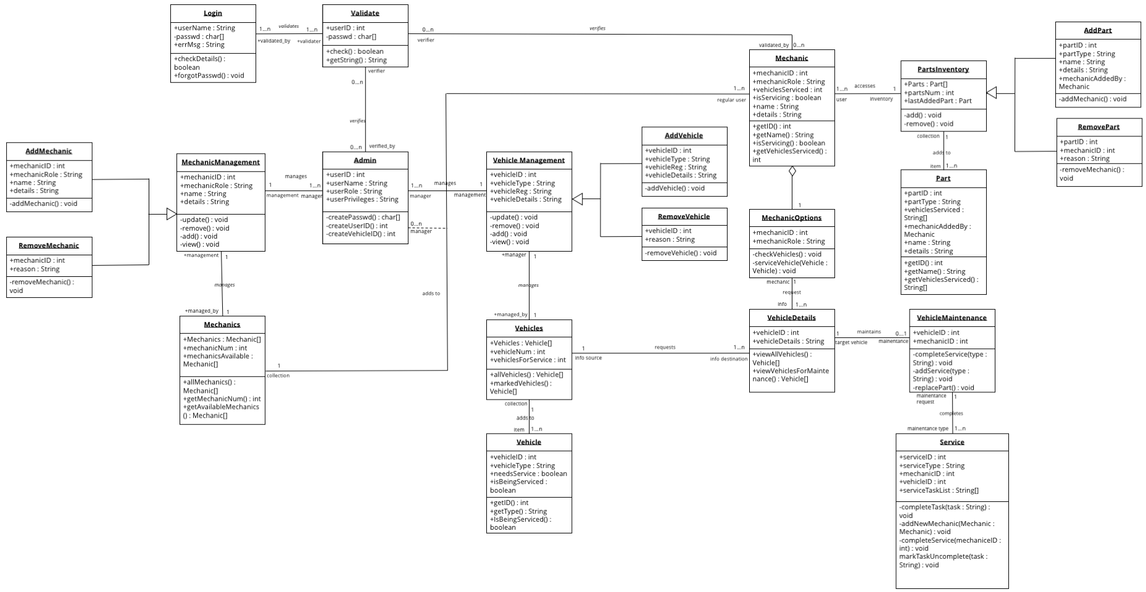
UML Class Diagram
Notes:
The class diagram shows the structure of a system by illustrating its classes, their attributes, operations relations to other objects.

Slide 22
Rationale Behind Class Diagram
Two Types of Users:
Mechanics
Managers (Admins)
Notes:
We decided to approach the class diagram by looking at the two different types of users who would use the system, regular mechanics and managers.

Slide 23
Rationale Behind Class Diagram
Mechanics
Vehicles
Maintenance
Parts
Add to inventory
Remove from inventory
Notes:
The mechanic can be seen as a regular user. They can access the database of vehicles and parts. They can perform maintenance on a vehicle and can add or remove parts from the inventory.

Slide 24
Rationale Behind Class Diagram
Two Types of Users:
Mechanics
Managers (Admins)

Slide 25
Rationale Behind Class Diagram
Managers
Inherit all of a regular mechanic’s functions
Vehicles
Add vehicles
Remove vehicles
Update vehicles
Mechanics
Add mechanics
Remove mechanics
Update mechanic information
Notes:
Managers are seen as system admins and can therefore complete all of the tasks of a regular mechanic as well as additional administration tasks. In addition, managers can add and remove vehicles from the system as well as add, remove and update mechanic information. That formed the basic layout for our class diagram.

Slide 26
Strengths and Weaknesses of Class Diagram

Slide 27
Strengths
Diagram gives a very in depth view of the different characteristics associated with Mechanics and Managers.
Very little cross - over of arrows making the diagram less confusing to interpret.
Notes:
The UML class diagram we designed gives and extremely detailed and in depth view of the various attributes associated with the two types of users, Managers and Mechanics. When designing the diagram, we strived to have as little cross over of arrows as possible, knowing that a large amount of cross overs would certainly make the diagram a lot more difficult to interpret.

Slide 28
Weaknesses
As a result of an in depth view, the large amount of classes, all with similarities in terms of name and attributes could possibly make the diagram more difficult to interpret.
Notes:
It was hard to make a perfect diagram and when deciding on our design, what we felt were small concessions had to be made. As a result of giving an in depth view of the functions of the various users, similarities both in names and attributes, as well as a large amount of classes occurred. On reflection, this may possibly make the model more difficult to interpret on initial viewing.

Slide 29
Example of scenario text for 1 Use Case

Slide 30
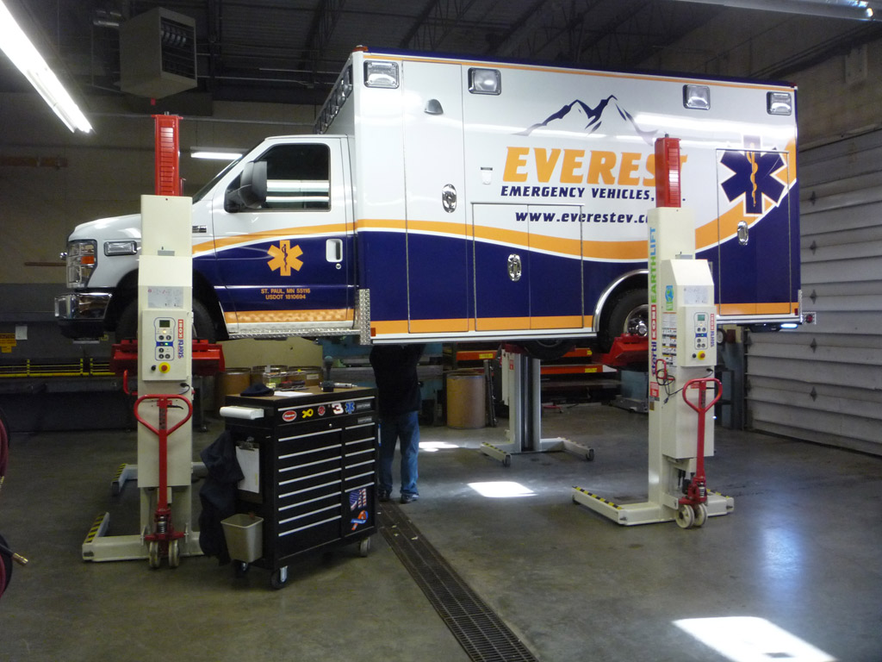
Minor Service
A Mechanic looks at the database of vehicles in need of minor service (mileage based).
The Mechanic picks a vehicle from the database and applies minor service.
Notes:
In this use case, a member of the vehicle maintenance team will use the system to check what vehicles need to be serviced and the system will tell him which one is in the most need of a service.

Slide 31
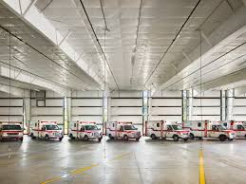
Minor Service
He then enters the details of the minor service in the database (changed the oil, filters, spark plugs, coolant, checked tires, brake fluid, etc...).
The Mechanic then marks minor service complete and marks in the time for the next service and details of the next service.
Notes:
The Mechanic will get a list of tasks to be completed from the system. For example checking the oil or the tyres, making sure the lights and sirens are working. As the Mechanic finishes each task he will mark it off on the system and once all of these tasks are completed he can sign off that the vehicle has been serviced and adds the details for the next service.

Slide 32
Strengths and Weaknesses of Design

Slide 33
Strengths
1. Solves problems related to maintaining the vehicle Fleet
2. Ensures maximum safety of vehicles in fleet
3. Historical traceability
Planning and Scheduling
Equipment Wash
Preventative Maintenance Inspection (PMI)
DVIR Repairs
PMI Repairs
Driver, Vehicle Inspection Reporting (DVIR)
Scheduled Repairs
Notes:
The first strength that our proposed system adds is that it solves problems relating to maintaining a vehicle fleet of any kind. This is particularly important in the case of emergency services as it it is vital that a vehicle fleet remains operational and safe for emergency response teams to use at all times. In order to achieve this, mechanics and service personnel must utilise an often complex series of steps to called a preventative maintenance process in order to ensure each vehicle in the fleet is operational. This process can be near impossible to implement without a system to track vehicles in the fleet to notify the maintenance team which vehicles are in need of which steps of the process.

Slide 34
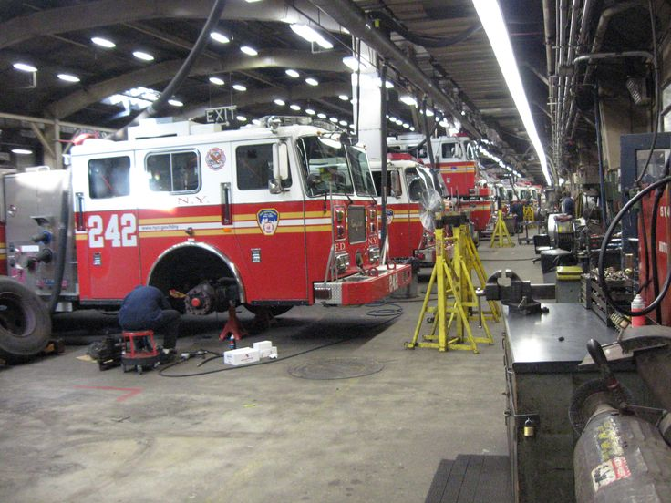
Strengths
1. Solves problems related to maintaining the vehicle Fleet
2. Ensures maximum safety of vehicles in fleet
3. Historical traceability
Notes:
Because the system allows any member of the maintenance team to check which vehicles are in need of a checkup as well as when all the other vehicles were last checked, the system removes quite a lot of the human error in vehicle maintenance. Chances of a vehicle missing a maintenance check or even missing part of a maintenance check are greatly reduced because the system takes care of tracking that for the maintenance team.DVIR Repairs

Slide 35
Strengths
Vehicle Service History
1. Solves problems related to maintaining the vehicle Fleet
2. Ensures maximum safety of vehicles in fleet
3. Historical traceability
Mechanics who worked on vehicle
Traceability
Parts Replaced on Vehicle
Parts available in warehouse at particular time
Notes:
The system also allows full transparency and traceability pertaining to information on every vehicle in the fleet such as its full service history, mechanics who worked on the vehicle, parts replaced or repaired on the vehicle as well as the inventory of parts available at the service centre’s warehouse at the time. This information can be very useful in the investigation of a case of a vehicle breaking down while on call for example and also adds a degree of liability and responsibility to all members of the maintenance team.

Slide 36
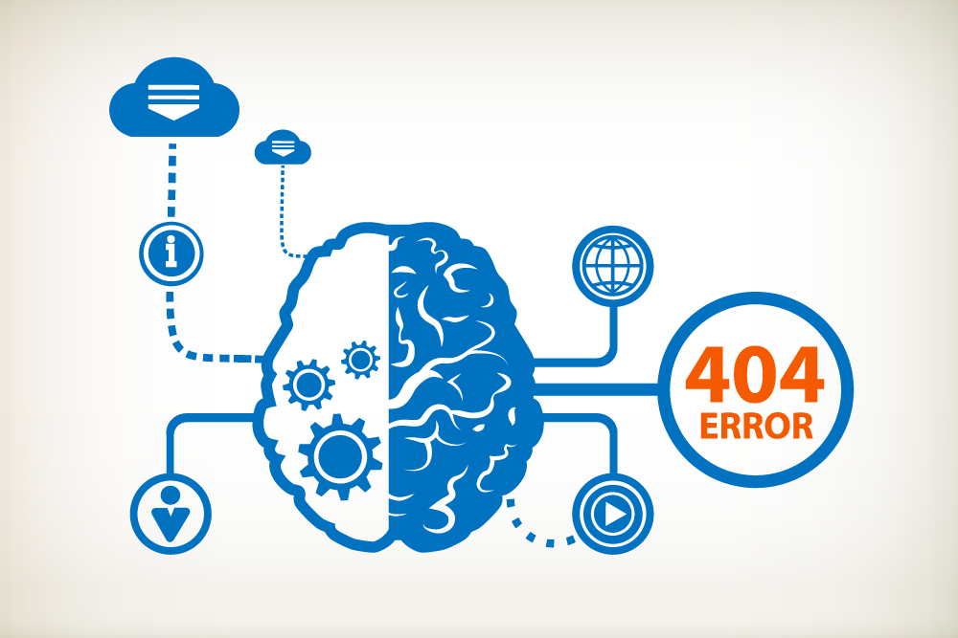
Weaknesses
1. Human Error
2. Reliability of Computers
3. Cost of System
4. Staff Training
Notes:
Although a computerised vehicle maintenance system greatly reduces the openness to human error, there is still no way of completely getting rid of it with this system. A technician can still incorrectly mark a vehicle as serviced, incorrectly update a vehicle’s history or mistakenly mark the vehicle as road worthy.

Slide 37

Weaknesses
1. Human Error
2. Reliability of Computers
3. Cost of System
4. Staff Training
Notes:
The reliability of the entire vehicle maintenance system will be placed entirely on that of computers. This may have many inherent issues, especially in a work environment not used to computerised systems. If a component of server breaks or the local network fails, the entire servicing department may grind to a standstill.

Slide 38
Weaknesses
System Hardware Costs
1. Human Error
2. Reliability of Computers
3. Cost of System
4. Staff Training
Installation Costs
Maintenance Costs
Notes:
Another issue associated with the reliability of the computers may be the cost of maintaining them. Introducing computers to the vehicle maintenance system adds another fixed cost firstly of acquiring the hardware for the system and labour to install it. Then the system must be maintained which would presumably require an external technician to service the hardware and apply software updates as needed.

Slide 39
Weaknesses
1. Human Error
2. Reliability of Computers
3. Cost of System
4. Staff Training
General Computer Literacy Training
Staff Training
System Specific Training
Notes:
The last issue with the system is the staff training that would have to be put in place to insure every member of the maintenance team can comfortably use the system. This may include computer literacy training as well as system specific training and will also add another inherent cost.

Slide 40
Thank You

